Slide 1

Graphs 3
CISC 3220 Lecture 11
By Ariel Avshalom

Slide 2
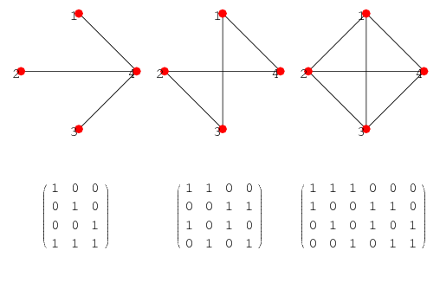
Representing graphs
There are two ways that are generally used to represent graphs:
Note: n are the nodes and m are the edges
An adjacency matrix Θ(n^2)
An adjacency list Θ(n+m)
There is also a representation called an incident matrix Θ(n*m) (nodes from top to bottom, edges from left to right):

Slide 3
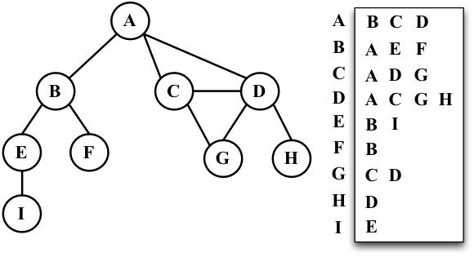
Adjacency list example
This representation uses a hash map and a linked list

Slide 4
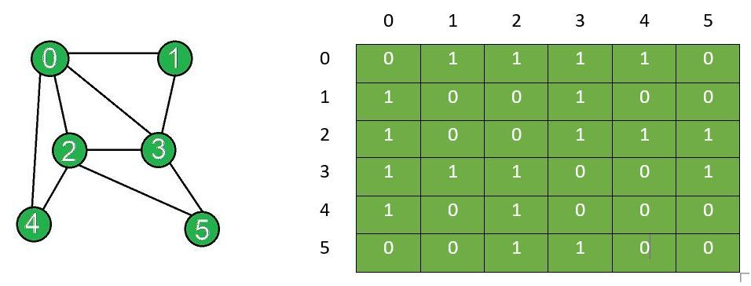
Adjacency matrix example
Note: you can replace the 1 values with the weights of edges

Slide 5
Which do you choose?
Adjacency matrices
Are simpler to implement and maintain
Are better for dense graphs
Adjacency lists
Are better for sparse graphs
Good for algorithms whose complexity depends on m
Incident matrices are not efficient for algorithms
Think…why not?

Slide 6
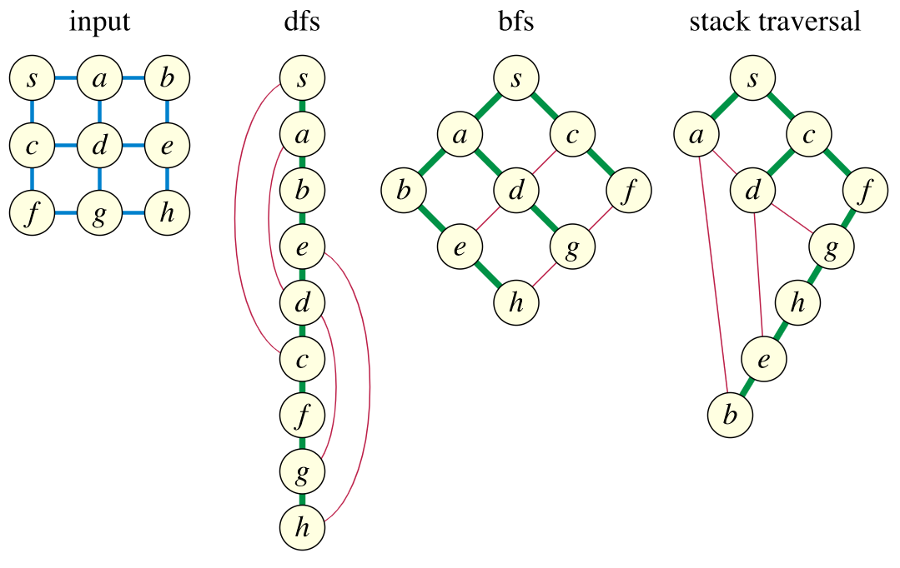
Graph traversals
Let’s say you want to find a traversal path that
Visits all the nodes of the graph
Traverses all the edges of the graph
Note that nodes and edges can be visited more than once
The input is a simple, undirected and connected graph
How do you do it? There are many algorithms…

Slide 7

General scheme
Pick a starting node and travel to another node it is connected to (since our graph is connected)
Using traversed edges go to one of the visited nodes that has an incident untraversed edge
Traverse the untraversed edge
Continue until all the edges are traversed
Like before, there are so many ways of doing this…

Slide 8
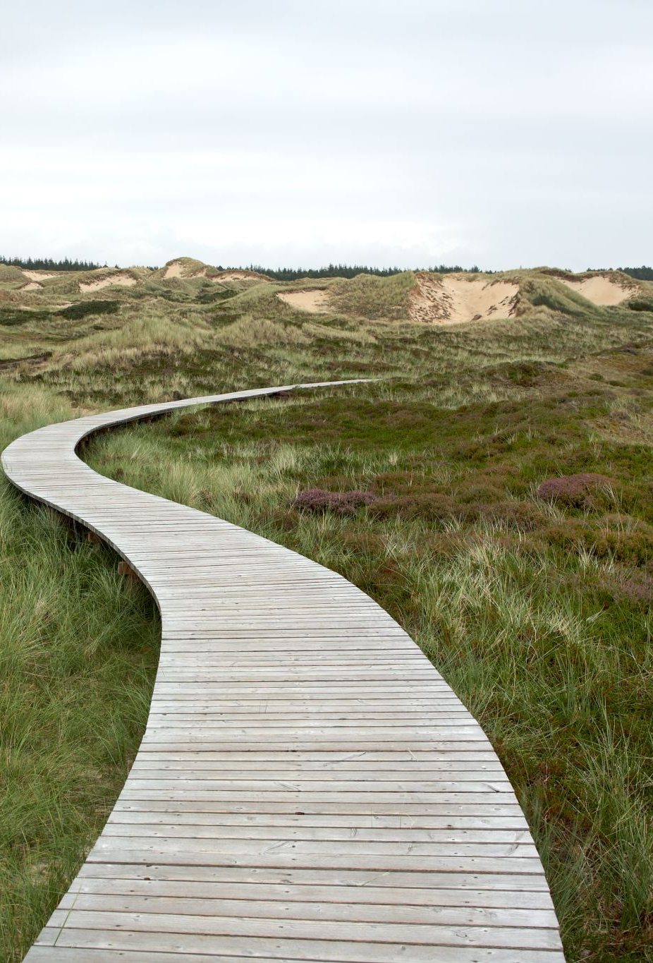
Objectives
In order to be efficient
The rules to find an untraversed edge should be simple
The data structure used should be efficient
The algorithm should take O(m) time
This is because edges tend to occur more than nodes
Example: A Euler path is the shortest possible traversal path since…
No edge is traversed more than once

Slide 9

Variants
Directed graphs: an edge is traversed only from its origin to its destination
Disconnected graphs:
When stuck, jump to an unvisited vertex
Continue until all vertices and edges are traversed
Finish fast in O(n+m) running time

Slide 10
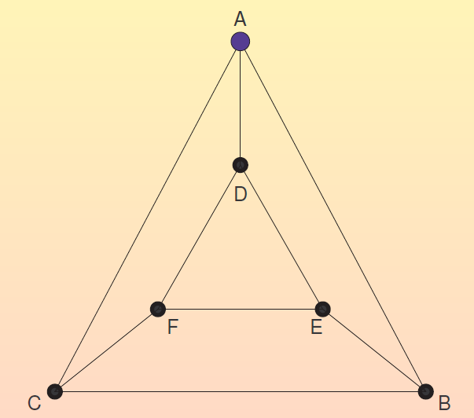
Example traversal using this graph:
Notes:
Final Traversal:
ABEDFEBCADFC

Slide 11
Traversal trees
Tree structure (rooted, ordered and directed):
The root is the first visited node of the tree
Node u is the parent of v if the first visit to v happened after traversing the edge (u,v)
The children of u are ordered according to the time they were first visited from u
Edge classification:
Tree edge: an edge from a vertex to one of its children
Back edge: an edge from a vertex to one of its ancestors
Forward edge: an edge from a vertex to one of its descendants which is not its child
Cross edge: an edge from a vertex to another vertex that is neither one of its ancestors nor one of its descendants in the traversal tree
Let’s do an example on OneNote

Slide 12
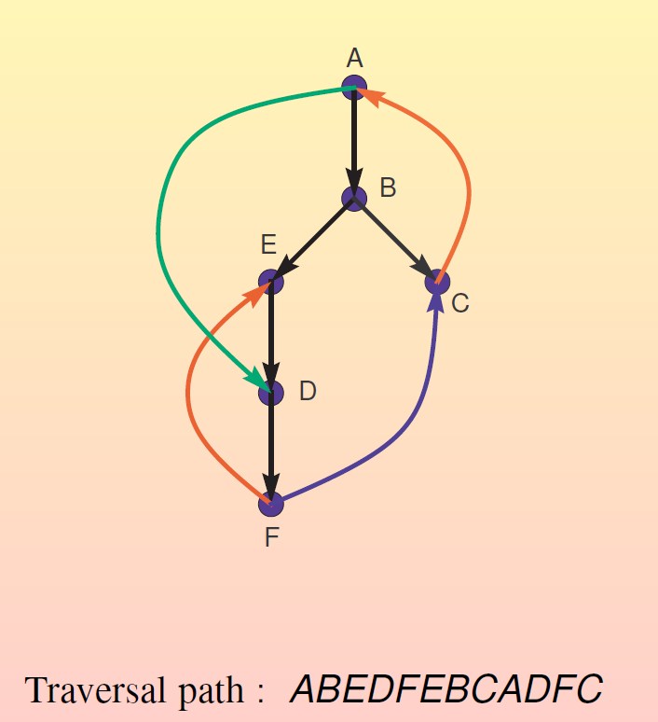
Traversal Example:

Slide 13

Depth first search (DFS)
This is a part of a question you might see during an interview!
Here is the main idea:
Visit a vertex then recursively visit all its neighbors in order
Output: A traversal forest that contains a traversal tree for each connected component of the graph
In a traversal forest, each tree is a directed tree
Recall that a forest is a bunch of connected trees
Check out this video for implementing a DFS, you can already see that a stack is necessary

Slide 14
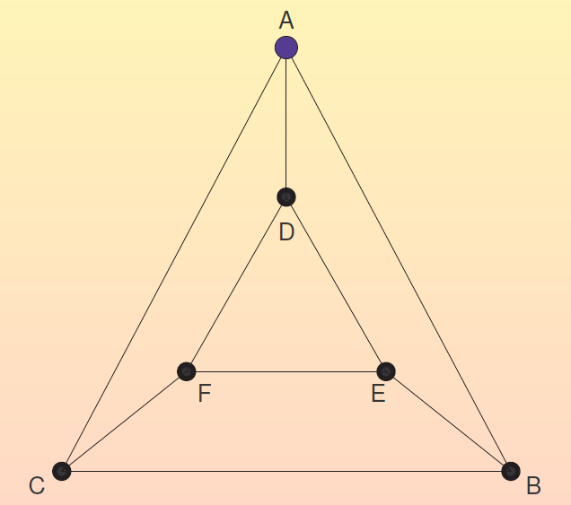
One more time!
Notes:
Path: ABCACFDADEBEF - EDFCBA

Slide 15
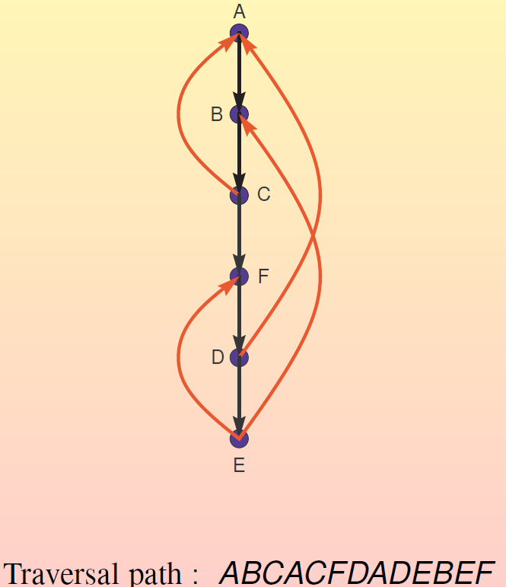
Here is how the final tree might look:
Notes:
ABCACFDADEBEF

Slide 16
How do we know that DFS is a correct traversal?
We know from before that DFS visits all the nodes
We also know that DFS traverses all the edges
This is because the DFS algorithm recursively goes through each of the neighboring nodes of a node

Slide 17

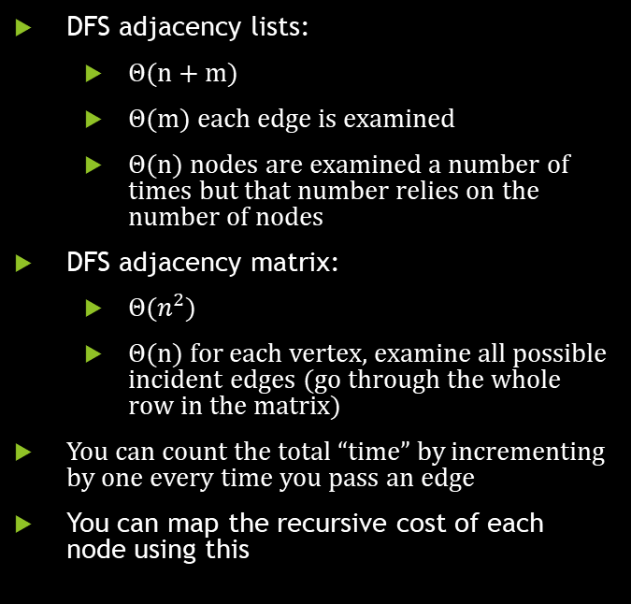
Algorithmic complexity
DFS adjacency lists:
Θ(n + m)
Θ(m) each edge is examined
Θ(n) nodes are examined a number of times but that number relies on the number of nodes
DFS adjacency matrix:
Θ$(n^{2})$
Θ(n) for each vertex, examine all possible incident edges (go through the whole row in the matrix)
You can count the total “time” by incrementing by one every time you pass an edge
You can map the recursive cost of each node using this

Slide 18
Is a DFS traversal a Directed Acyclic Graph (DAG)
A directed graph is a DAG if it is directed and has no cycles
Note that this also means you can’t create a Eulerian Path
So is a DFS a DAG?
Think about it a while on your own…
Check out this video of a topological sort of a DAG
Topological sort: a linear ordering of its vertices such that vertex u appears before vertex v for any directed edge (u -> v)

